Slide 1
Nearest State and County Finder
Haotian Chen, Yang Hu, and Gordon Wallace
EC504
December 5, 2019
Git: https://github.com/HaotianCheng/Nearest-State-and-County

Slide 2
Intro
The goal:
Given a lat/long coordinate, find the K nearest reference points in US Board on Geographic Names dataset
Implement this using three different data structures (Quad tree, R tree, Kd Tree)
Compare runtimes
CLI for input and displaying results

Slide 3
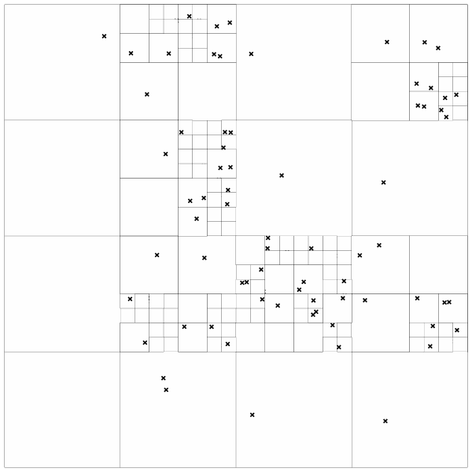
Quad Tree
What is it?
It is used to Store data of points on a 2-D space
It decomposes space in to adaptable cells
Each cell can store points as a QuadTree leaf or contain 4 children cells to store points
Each cell has its maximum capacity to store points. When stored points went over the limit, the cell splits.
How do we search for nearest points?
Start from the root cell to see if it has child that may contain the target point
Do recursive searching till we find the leaf cell that the target point cannot go any deeper
If the leaf cell contains any point, we store it as temporary one of the closest points
Loop all the cells along the searching path to see if it may contain points that closer than the farthest stored point. If it may has, dig in. If it does has, replace the farthest stored point
https://dev.solita.fi/img/quad-tree/quad-tree.png
Reference: http://users.umiacs.umd.edu/~ramani/cmsc878R/p187-samet.pdf

Slide 4
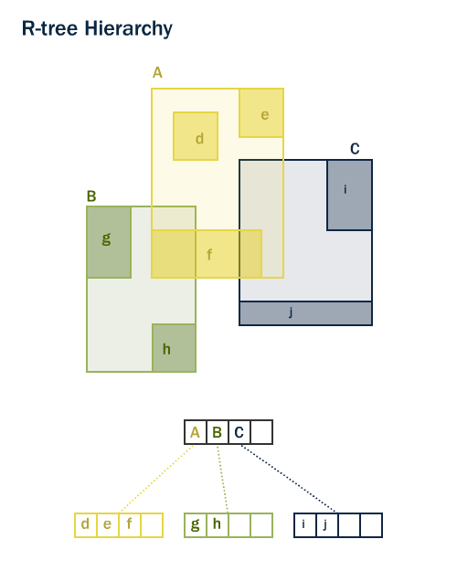
R Tree
What It Is
Tree of minimum bounding rectangles
Children of a node are entirely contained by the node
Balanced (all leaves at same level)
Nearest Neighbor Search
Two criteria for each MBR
Smallest possible distance to an object within relative to point in question (mindist)
Largest possible distance to the closest object within (maxdist)
Using DFS, keep a list of possible branches, replacing as necessary
Before each recursion, eliminate branches whose mindists are larger than maxdists of other branches
Reference: http://www.cs.umd.edu/~nick/papers/nnpaper.pdf
Graphic: https://postgis.net/workshops/postgis-intro/indexing.html

Slide 5
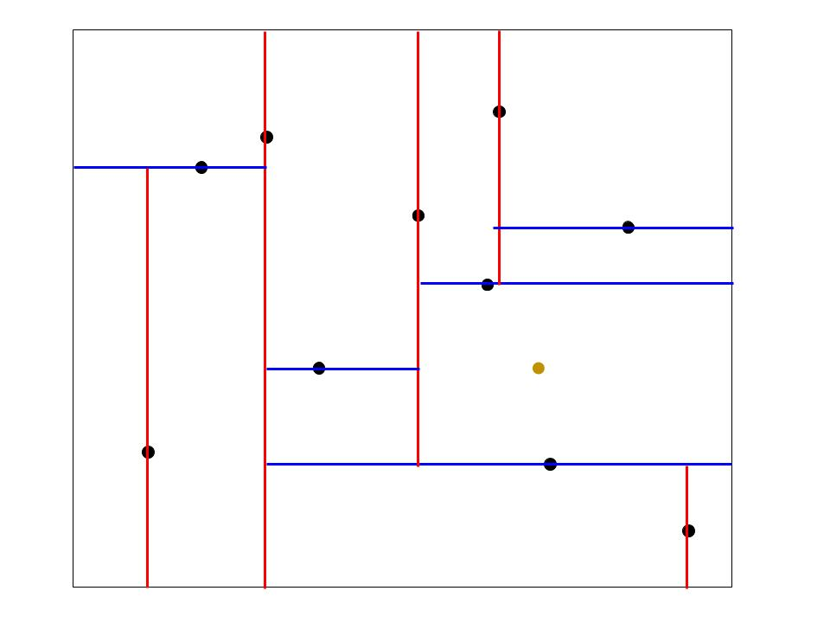
Kd Tree
What it is:
Essentially it is a BST; sorted from left to right
Partition 2-D space into halves
Starting from root, partition through x and y coordinates alternatively
Bringing the nearest points:
Go through each depth, compare x and y coordinates correspondingly, find the closest point so far
Prune subtrees of the closest point so far, and update the closest point to look for a shorter distance
if found, recursive call to find subtree of new closest point
else, done searching current closest node subtree and go for the less promising space for
NOTE: the search traverse the tree with pruning conditions
Reference: https://www.cs.cmu.edu/~ckingsf/bioinfo-lectures/kdtrees.pdf
Notes:
Ways to implement Kd tree:
Median partitioning insertion was considered. Didn’t use because large amount of data needed to be handled. The fastest median finding way also requires sorting numbers in order. The runtime might get unnecessarily big.
Cons on implementation:
Since the tree is not inserted as a balanced tree, the height of the tree is likely to be large
Due to the previous flaw, searching a node can be more time consuming than expected

Slide 6
Comparison
Efficiency of R tree search depends on quality of tree. Worst case O(n), where all MBRs overlap, so distances from point to every location must be calculated
Efficiency of Quad Tree is O(log(n)) on average. However, a bad quality Quad Tree can lead to the worst case of its operation time which is O(n).
Average runtime of Kd tree insertion is O(log(n)) and worst runtime can go O(n). For bringing the closest coordinates, the worst runtime is O(n).
Notes:
for KD tree, in practice the average runtime would be O(2^d + log(n)) where 2^d is to search around the cells in neighbors

Slide 7
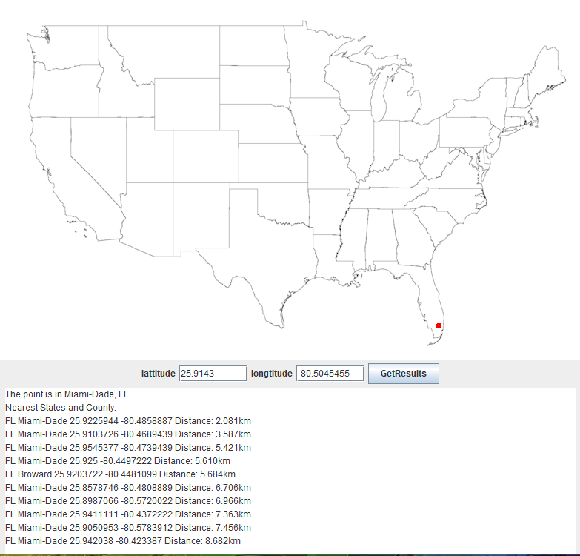
Show Case:

